Slide 1
Data Structures and Algorithms -3 (25CS2103E)
Title of the project
Team Members
M. Keerthi Sri – 2520030079
N. Greeshma – 2520030080
K. Swathi Sree - 2520030410
Under the Esteemed Guidance of
Dr. S. Madhavi
Assisstant Professor, CSE.

Slide 2
Contents
Abstract
Introduction
Literature survey
Problem Statement and Objectives
Hardware and Software requirements
Results
Conclusion
Future Scope

Slide 3
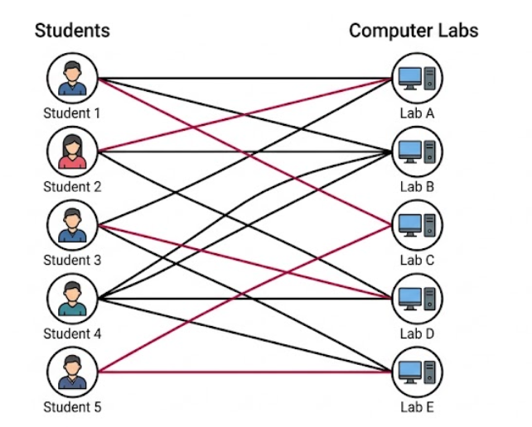
Abstract
Laboratory allocation is a scheduling problem involving student
preferences and limited laboratory capacity.
Manual or naïve allocation can result in inefficient assignments,
student dissatisfaction, and resource underutilization.
The system represents students and laboratories/lab seats as
two sets of vertices in a bipartite graph.
Edges represent possible student–lab assignments or preferences.
Laboratory capacity is considered during the allocation process.
A separate seating optimization stage arranges students in suitable physical positions.
The system provides allocation reports, statistics, and visualization of the matching and seating arrangement.

Slide 4
Introduction
Laboratory allocation involves assigning students to available laboratory sessions while considering preferences and capacity constraints.
Manual allocation becomes difficult when the number of students and available laboratory seats increases.
The proposed system uses a bipartite graph to represent the relationship between students and laboratory seats.
Students form one set of vertices, while available laboratory seats form the other set.
An edge represents a possible assignment between a student and a laboratory seat.
The Hopcroft–Karp algorithm is applied to find the maximum matching.
The system aims to maximize the number of students successfully allocated without assigning the same seat to multiple students.
After lab allocation, seating optimization distributes students across physical seats while attempting to maintain spacing and branch distribution.
The final system provides allocation information, seating visualization, statistics, and reports.

Slide 5
Problem Statement and Objectives
Objectives:
Automate student-to-laboratory allocation.
Represent student–lab preferences using a bipartite graph.
Apply Maximum Bipartite Matching using Hopcroft–Karp.
Maximize the number of successful allocations.
Ensure that each student receives at most one allocation.
Respect laboratory capacity constraints.
Provide allocation reports and statistics.
Visualize students, laboratories, and matched edges.
Optimize physical seating arrangements after allocation
Problem Statement
Assigning students to laboratory sessions while considering their preferences and laboratory capacity is a challenging scheduling problem. Manual or naïve allocation may lead to inefficient assignments, student dissatisfaction, and underutilization of laboratory resources. Therefore, an automated system is required to maximize successful student–lab assignments while respecting laboratory capacity and allocation constraints.

Slide 6
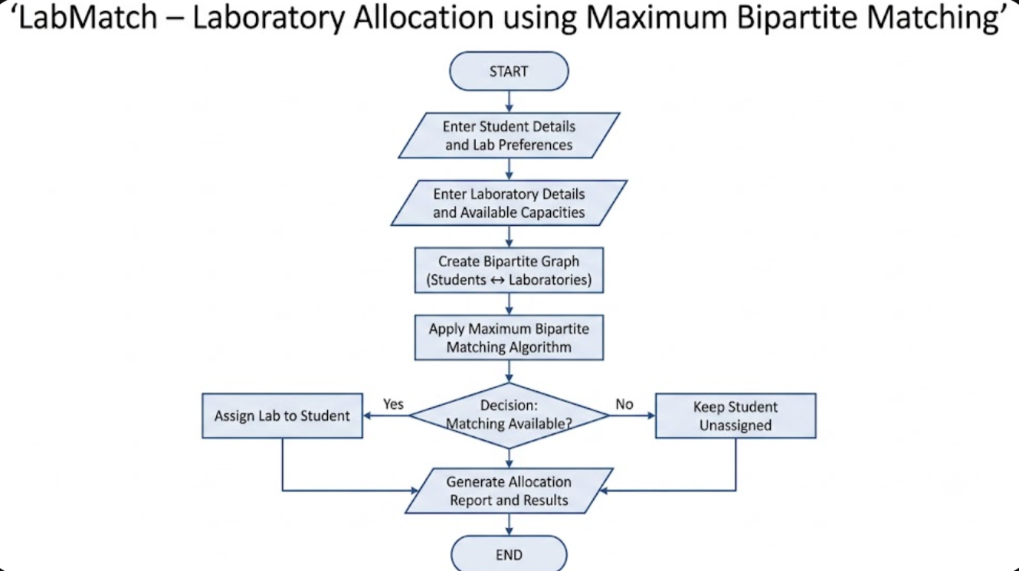
Flow Chart

Slide 7
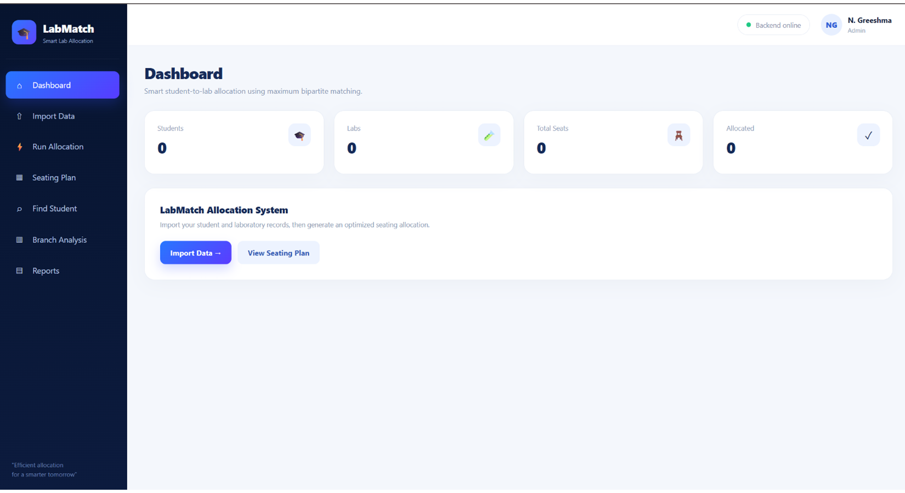
Results
The system provides an automated allocation process with the following results:
Students can be assigned to suitable laboratories based on available capacity and preferences.
Maximum Bipartite Matching maximizes the number of successful allocations.
Each student is assigned at most one laboratory seat.
Laboratory utilization can be displayed through allocation reports.
Student and laboratory information can be visualized using a bipartite graph.
Lab-wise allocation information can be generated.
Physical seating positions can be assigned after laboratory allocation.
Available and assigned seats can be displayed in the seating plan.
Allocation statistics and reports can be generated.

Slide 8
Hardware and Software requirements
Software:
Component | Requirement
Frontend | HTML, CSS, JavaScript
Backend | Java
Core Algorithm | Maximum Bipartite Matching / Hopcroft–Karp
Data Structure | Bipartite Graph
Database | MySQL
Visualization | JavaScript-based visualization
IDE | Visual Studio Code / IntelliJ IDEA
Version Control | Git & GitHub
Minimum 4 GB RAM
Internet Connection
Keyboard and mouse
Hardware

Slide 9
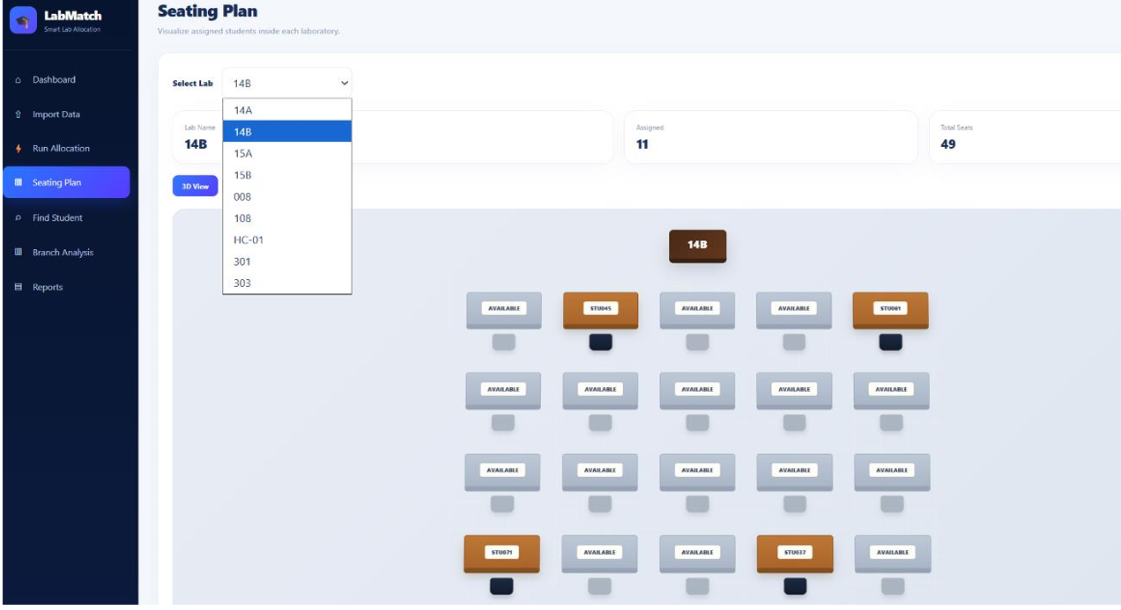
Conclusion
The Automated Student–Lab Allocation system provides a graph-based solution for handling student laboratory allocation. By representing students and laboratory seats as a bipartite graph and applying the Hopcroft–Karp algorithm, the system can obtain a maximum matching while respecting allocation constraints. The additional seating optimization, visualization, and reporting features provide an organized way to manage and understand the allocation results.

Slide 10
Future Scope
Integration with college student management systems.
Real-time student and laboratory data synchronization.
Support for larger student and laboratory datasets.
Advanced student preference handling.
More seating constraints and optimization rules.
Automatic generation of printable seating charts.
Improved graph and seating visualization.
Advanced allocation statistics and analytics.
Role-based access for students, faculty, and administrators.
Cloud-based deployment for centralized access.

Slide 11
Thank you

